Slide 1
Employee Data Analysis using Excel
STUDENT NAME: Anitha.S
REGISTER NO: 312216907
DEPARTMENT: Bcom(General)
COLLEGE: Shri Krishnaswamy College for Women

Slide 2
PROJECT TITLE
Salary and Compensation through Excel Data modelling

Slide 3


AGENDA
Problem Statement
Project Overview
End Users
Our Solution and Proposition
Dataset Description
Modelling Approach
Results and Discussion
Conclusion
3/21/2024 Annual Review

Slide 4

PROBLEM STATEMENT
Problem Statement: "As a compensation analyst, I have been tasked with analyzing the salary and compensation data of our company's employees to identify trends, disparities, and areas for improvement.
The data is currently stored in an Excel spreadsheet and includes variables such as employee ID, job title, department, location, salary, benefits, and bonus. My goal is to use Excel data modeling techniques to:-
Clean and preprocess the data- Develop a data model that accurately reflects the compensation structure- Analyze the data to identify trends and disparities in salary and compensation- Develop recommendations for adjusting the compensation structure to ensure equity and competitiveness

Slide 5

PROJECT OVERVIEW
Objective:- Analyze employee salary and compensation data to identify trends, disparities, and areas for improvement- Develop a data-driven approach to inform compensation decisions and ensure equity and competitiveness
Scope:- Collect and clean employee data from HR systems and other sources- Develop an Excel data model to analyze salary and compensation data- Identify key metrics and KPIs to measure compensation effectiveness- Analyze data to identify trends, disparities, and areas for improvement- Develop recommendations for adjusting the compensation structure- Present findings and recommendations to stakeholders

Slide 6

WHO ARE THE END USERS?
HR Professionals: To analyze and manage employee compensation, identify trends, and make data-driven decisions
2. Compensation Analysts: To design and implement effective compensation plans, conduct market research, and ensure equity.
3. Financial Analysts: To understand salary expenses, forecast budgets, and optimize resource allocation.
4. Business Leaders: To make informed decisions about staffing, budgeting, and talent management.
5. Operations Managers: To streamline processes, identify areas for improvement, and manage labor cost

Slide 7

OUR SOLUTION AND ITS VALUE PROPOSITION
Identify the Problem:
Understand the need: What specific issue or challenge does your solution address? For example, if your solution is a software product, it might solve problems related to inefficiency, high costs, or lack of scalability.
Target audience: Who is experiencing this problem? Understand the demographics, pain points, and needs of your target market.

Slide 8
Dataset Description
Data Collection Method:
Explain how the data was collected. Mention whether it’s self-reported, generated through surveys, sourced from company records, etc. Example: "Data was collected through HR systems and includes payroll records, performance ratings, and departmental assignments.
Data Structure:
Describe the structure of the dataset, including the number of rows and columns, and any hierarchical relationships. Example: "The dataset consists of 5,000 rows and 12 columns, with each row representing an individual employee."

Slide 9

THE "WOW" IN OUR SOLUTION
Automated Insights and Reports
Why it’s "Wow": Automating the generation of compensation reports and insights saves significant time and ensures consistency. Users can make informed decisions faster, which is crucial in dynamic business environments.
Customizable Dashboards
Why it’s "Wow": The ability to create customized dashboards that provide real-time insights into salary trends, disparities, and budget forecasting is highly valuable. It allows decision-makers to have a clear, visual understanding of their compensation data at a glance.
Scenario Modeling with What-If Analysis
Why it’s "Wow": Offering tools to model various compensation scenarios, such as salary increases, bonus adjustments, or changes in benefits, gives HR professionals the power to predict outcomes and make proactive decisions. This capability can lead to more strategic and data-driven compensation planning.
3/21/2024 Annual Review
9

Slide 10
MODELLING
Data Preparation
Input Variables: Identify key variables such as base salary, bonuses, benefits, overtime, and any other forms of compensation. Collect historical data for these variables.
Assumptions: Define any assumptions, like annual salary increases, bonus percentages, or benefit costs, that will feed into your model.
Forecasting
Trend Analysis:
Use historical data to forecast future compensation trends with linear regression or Excel’s Forecast function. This could include projecting salary increases over time.
Budgeting Models:
Create models to project total compensation expenses for the next year or several years, based on current data and assumptions
Benchmarking
External Benchmark Models:
Integrate external data sources to benchmark your salary data against industry standards. Use VLOOKUP or INDEX-MATCH to compare your internal data with market data
10

Slide 11
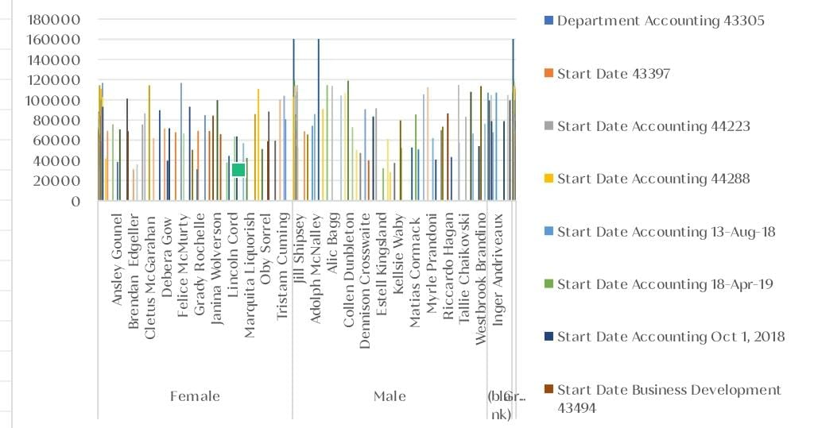
RESULTS
11

Slide 12
conclusion
Data Collection and Organization:
Collecting detailed employee compensation data, including salaries, bonuses, benefits, and other remuneration.
Organizing this data in Excel in a structured format, often using tables, to ensure it’s easy to analyze.
Benchmarking:
Comparing internal compensation data with external market benchmarks to ensure competitive pay structures.
Adjusting salaries and benefits to align with industry standards or company goals.
Forecasting and Budgeting:
Predicting future compensation costs based on historical data and projected changes (e.g., planned salary increases or hiring).
Creating budgets for compensation expenses and aligning them with organizational financial planning.

